Slide 1

EdTech Challenge
Expecto PatroNull

Slide 2
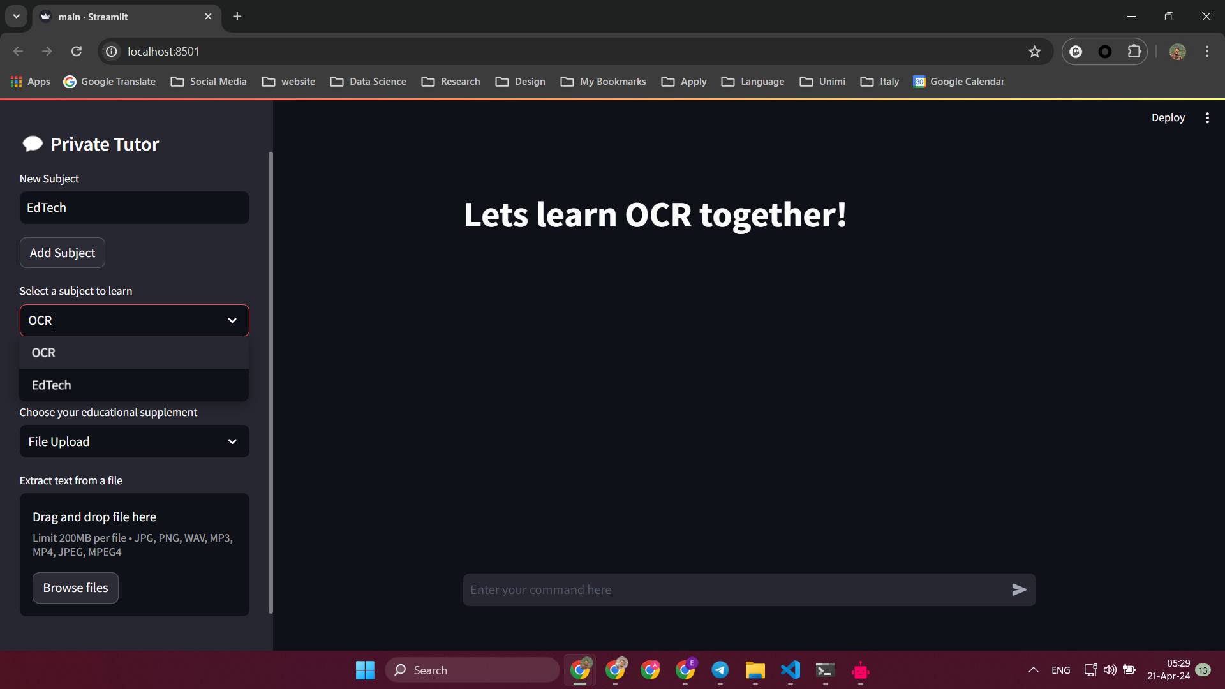


WebApp Environment

Slide 3
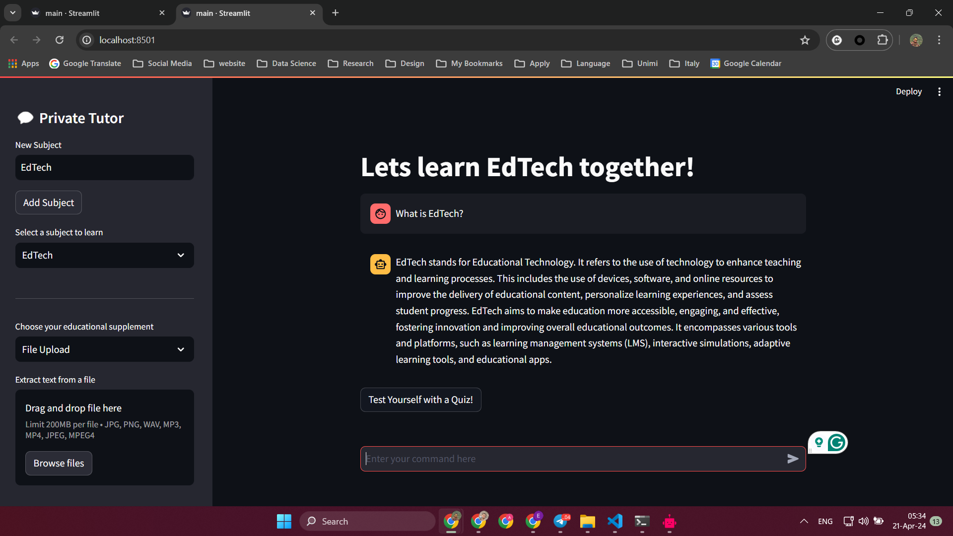



Treat it like a normal Chatbot!

Slide 4
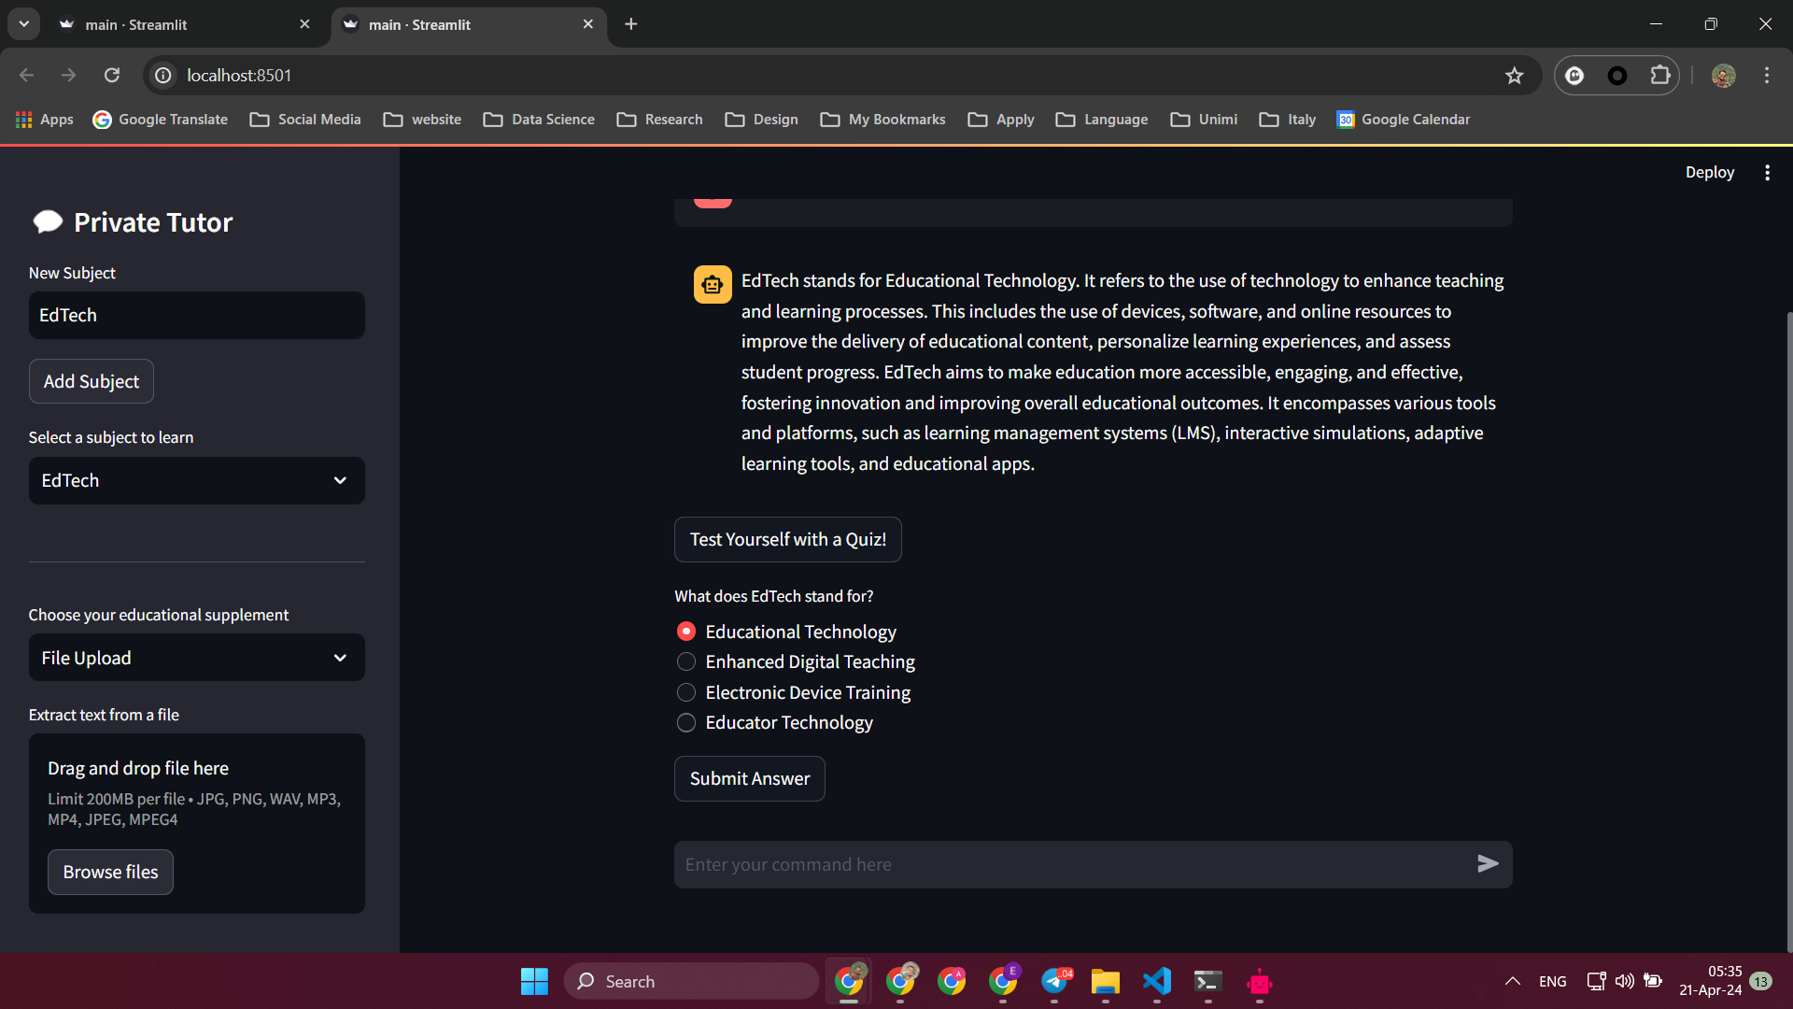






We can perform the quiz at any time!

Slide 5
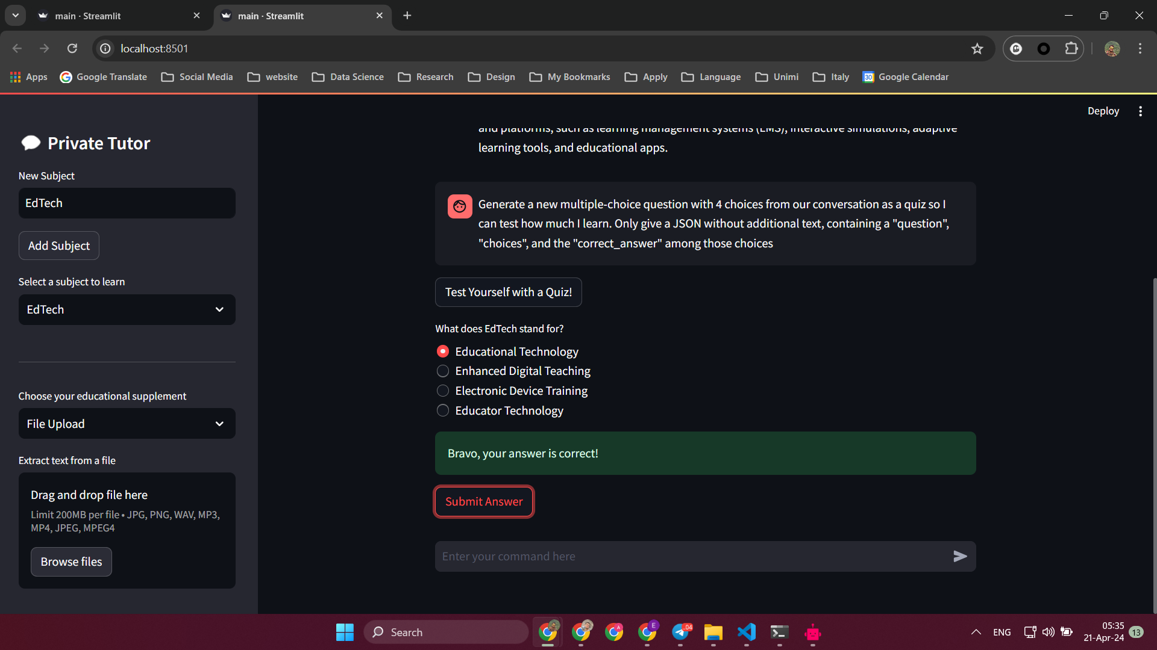



Slide 6
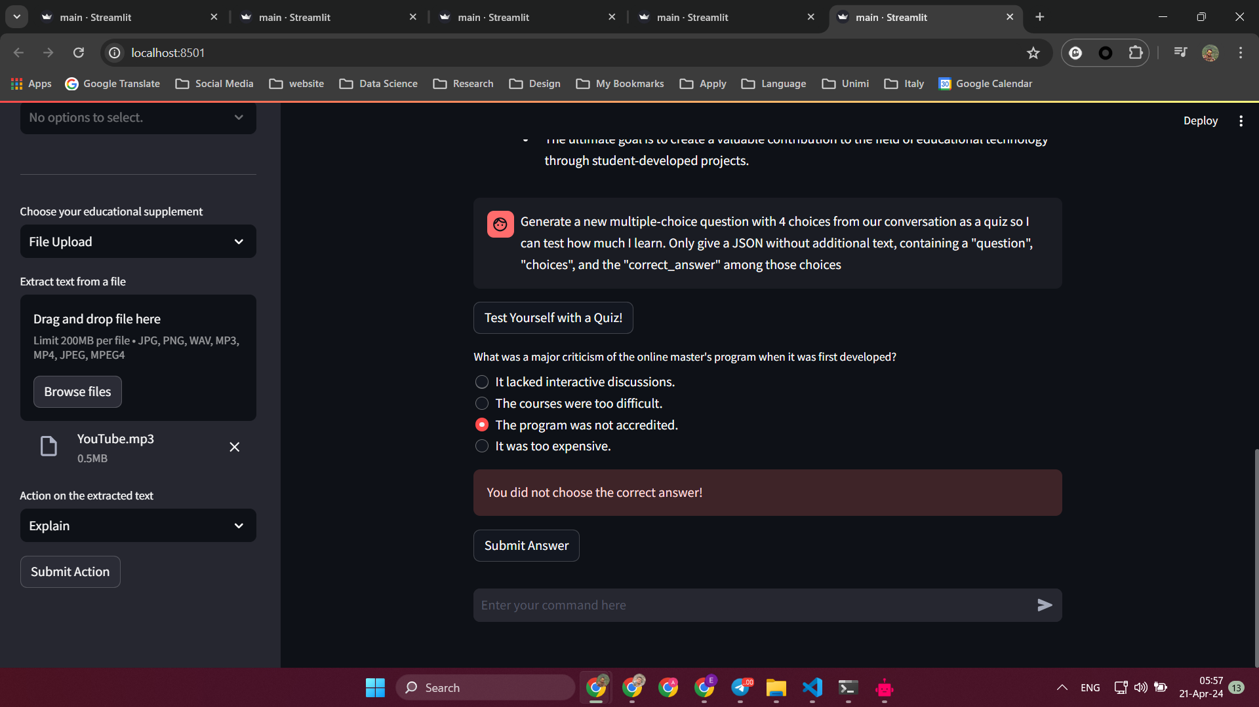







We can evaluate your responses

Slide 7
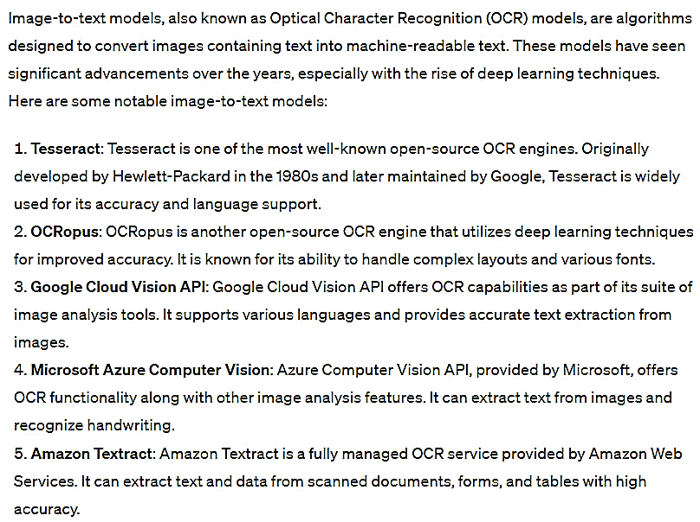
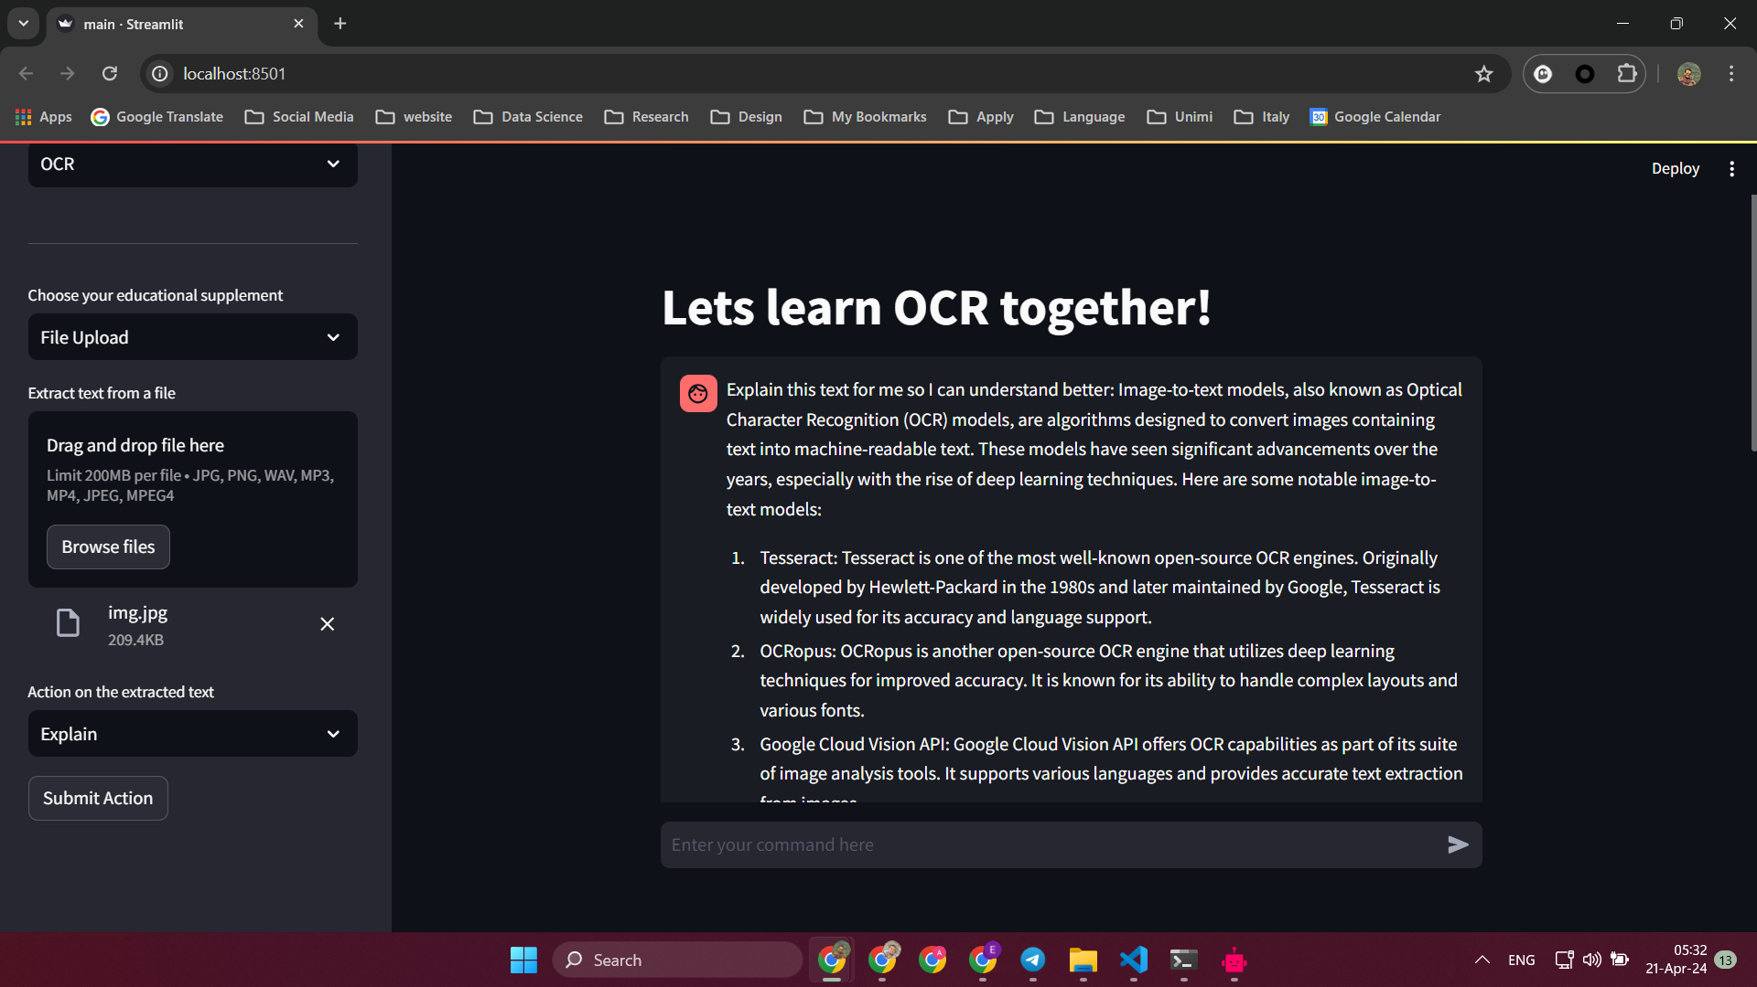






You can upload images

Slide 8
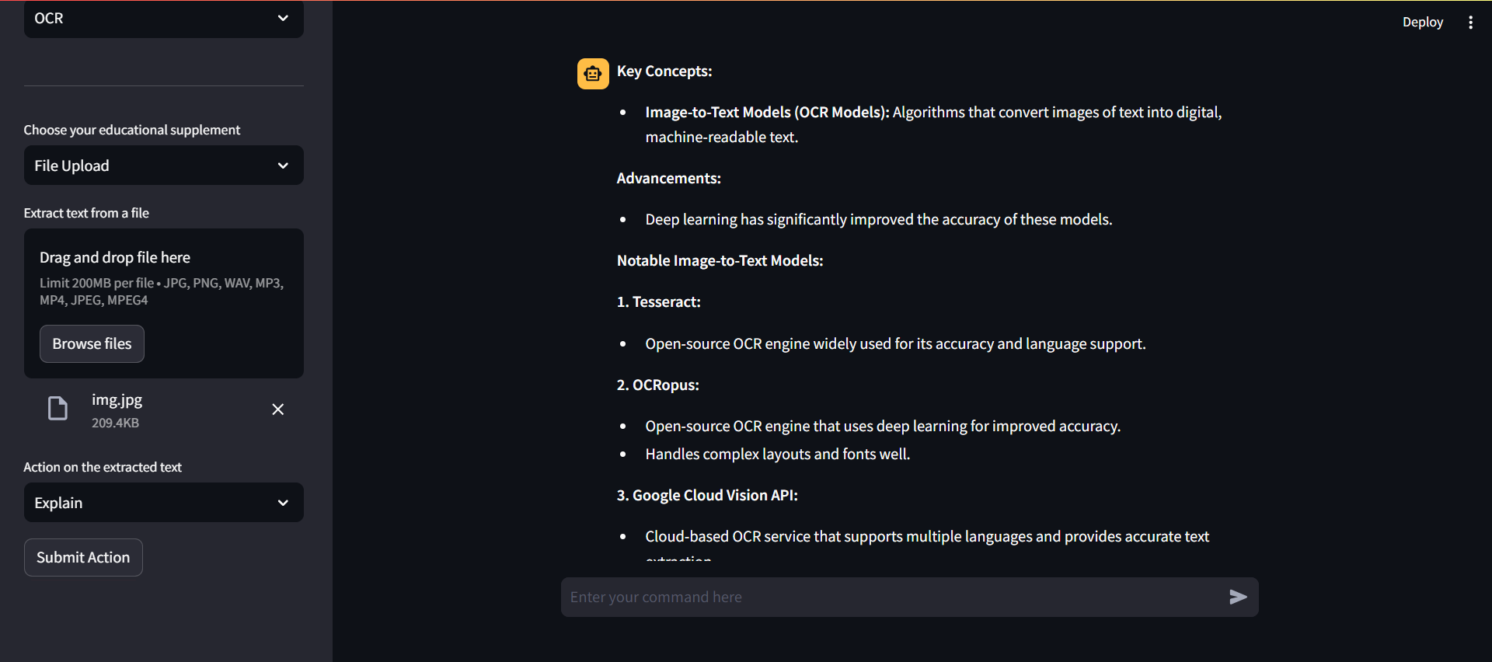
Tutor’s response: Explanation

Slide 9
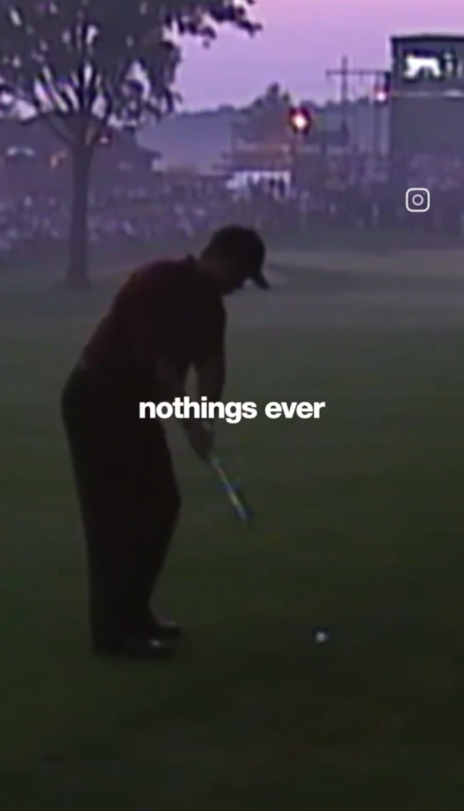
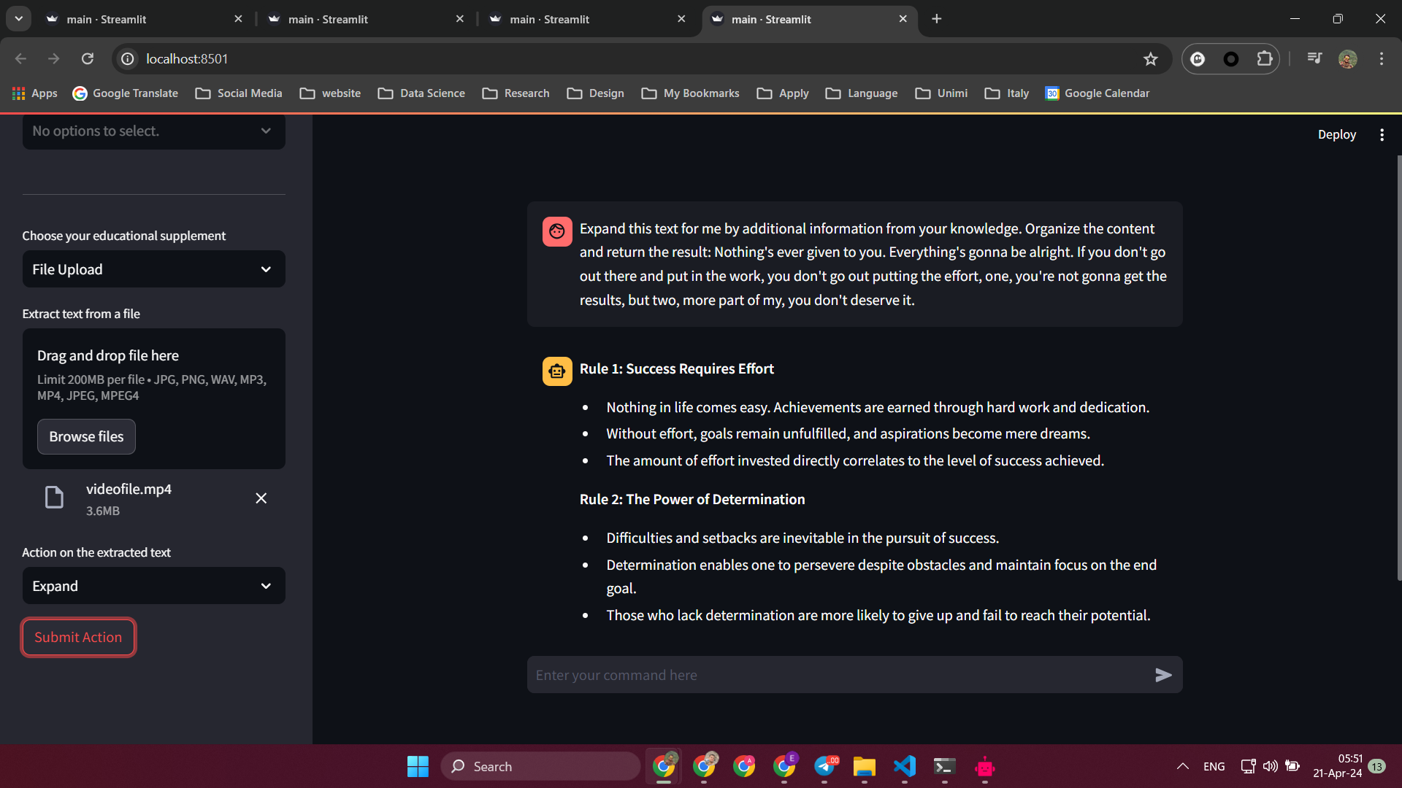







You can upload videos locally…

Slide 10
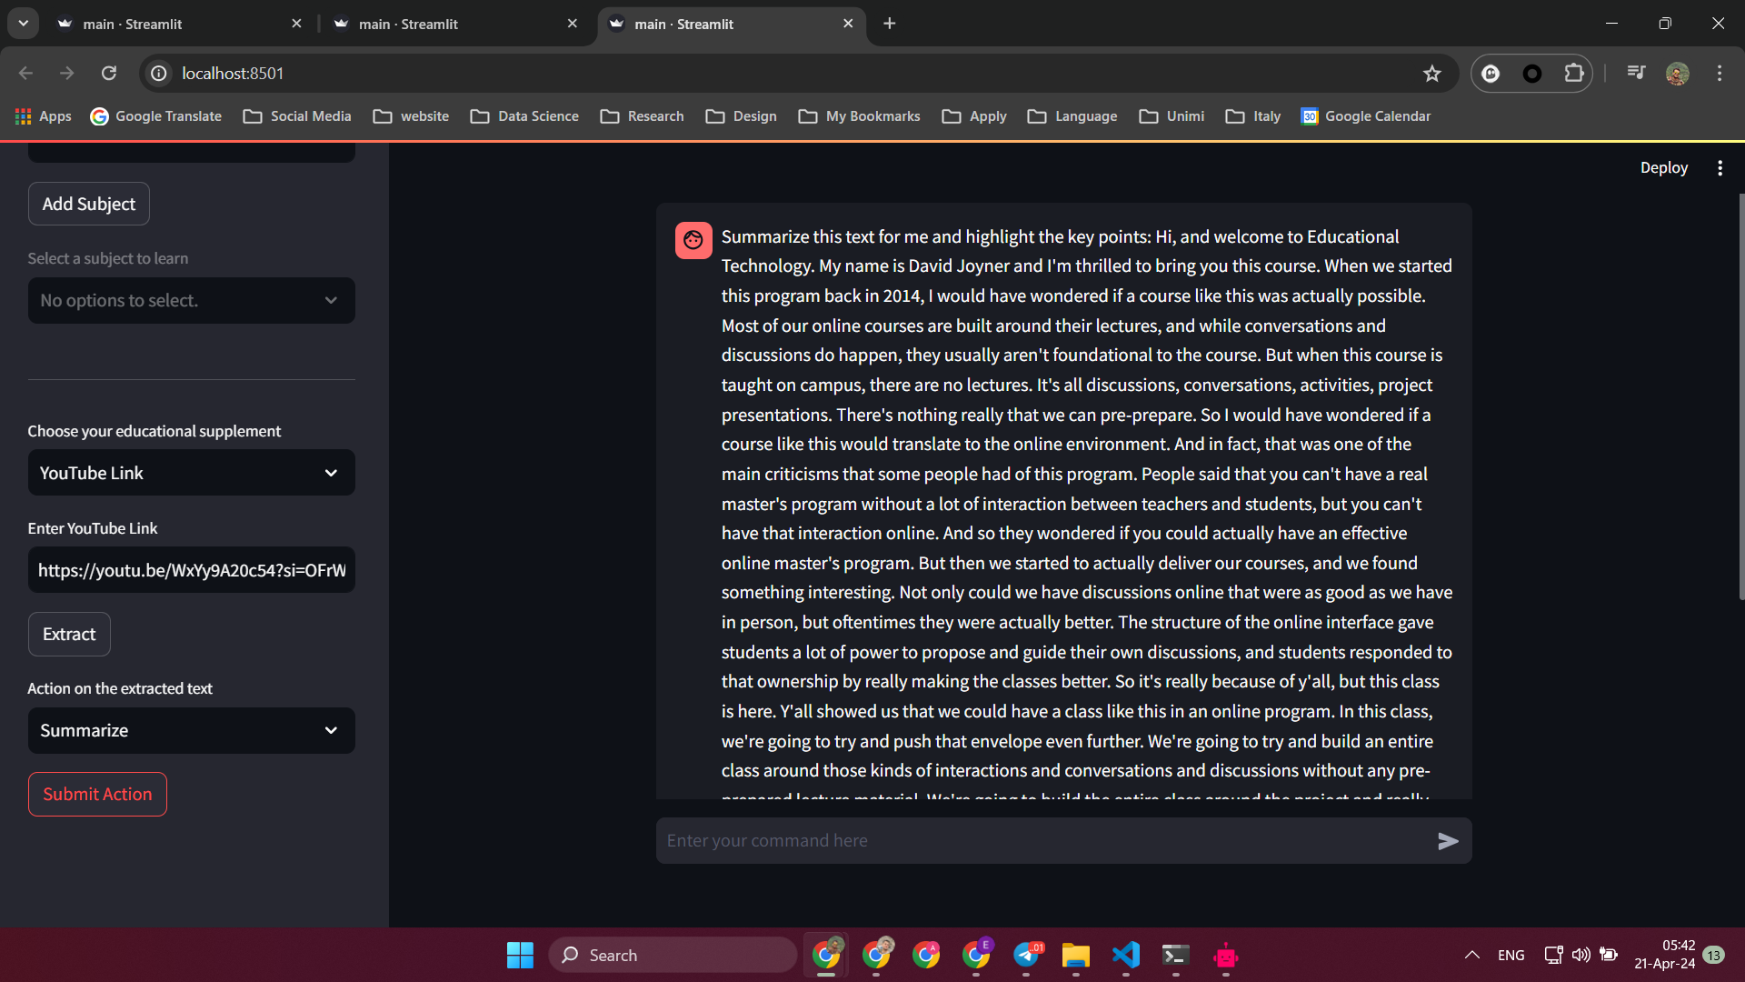
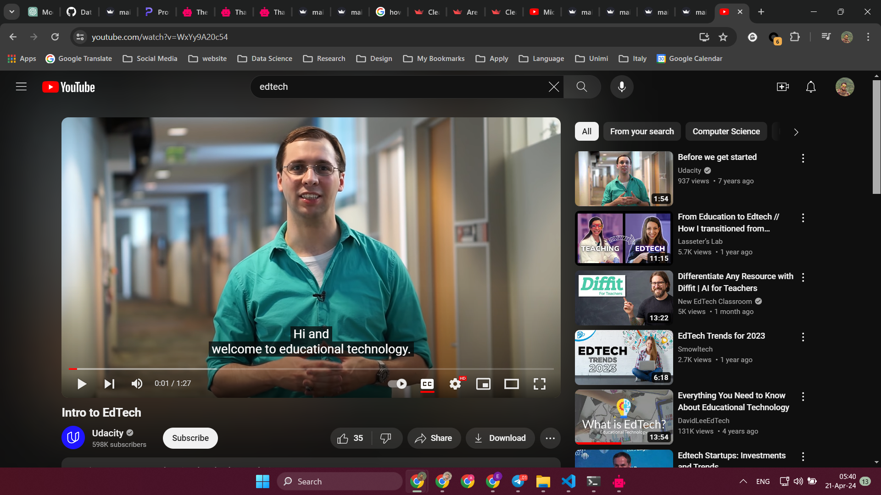
You can also use YouTube links
Found a YouTube
tutorial?
Send it to Tutor
and Learn with
more options

Slide 11
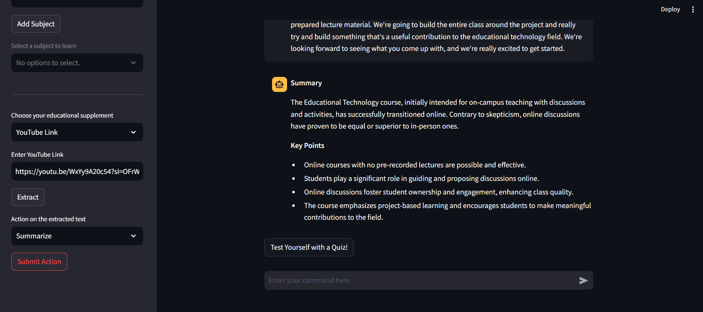

Tutor’s response: Summarization
Summarize the
information so,
you can recall or
review the
key point …

Slide 12
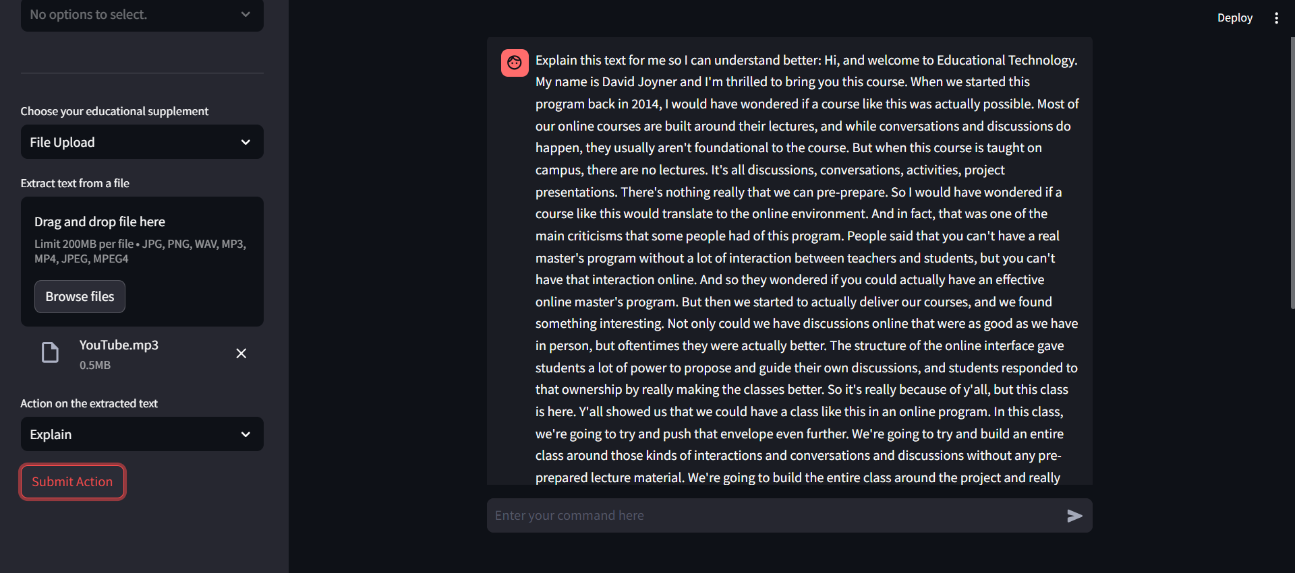
Upload Audio

Slide 13
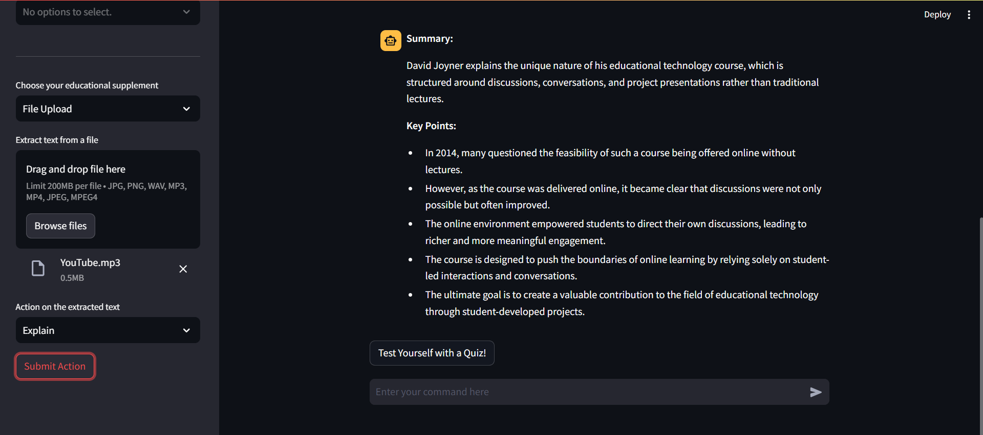
Tutor’s response: Explanation
Or command for
more explanation
on the topic

Slide 14
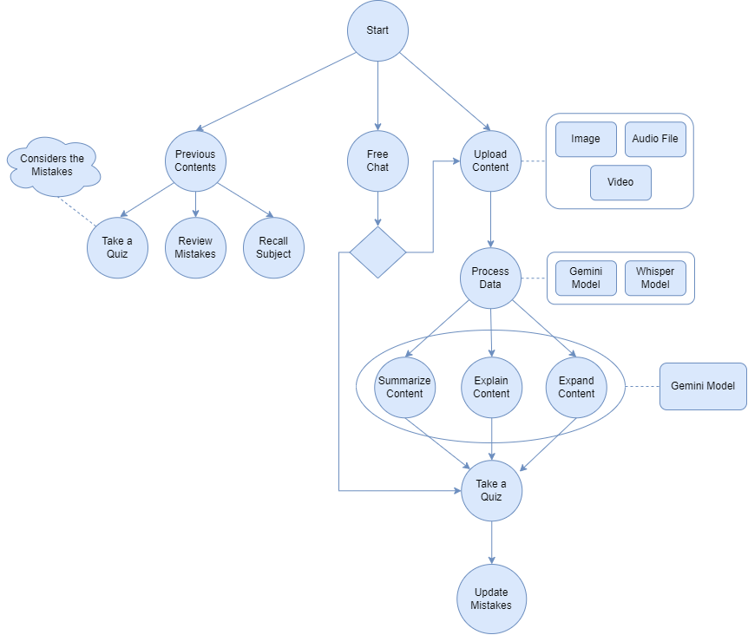
Block Diagram

Slide 15


GitHub Repository
Web Application Live Demo
https://edtech-llm.streamlit.app/
https://github.com/tabaraei/edtech

Slide 16
Thank You for Your Attention
Expecto PatroNull

